Slide 1
Chapter 06 Robust Estimation of Homography
Prof. Lin ZHANG
School of Computer Science and Technology
Tongji University

Slide 2
Outline
Problem of Homography Estimation
RANSAC-based Homography Estimation

Slide 3
Problem of Homography Estimation
Problem definition:
On two projective planes and , there is a set of corresponding points , and we suppose that there is a homography matrix linking the two planes,
Coordinates of and are known,
we need to find H
Note: H is defined up to a scale factor. In other words, it has 8 DOFs

Slide 4
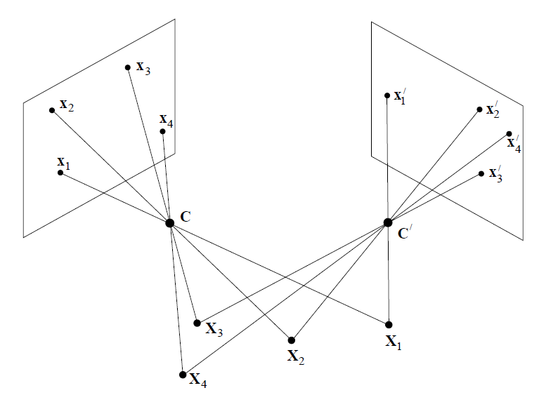
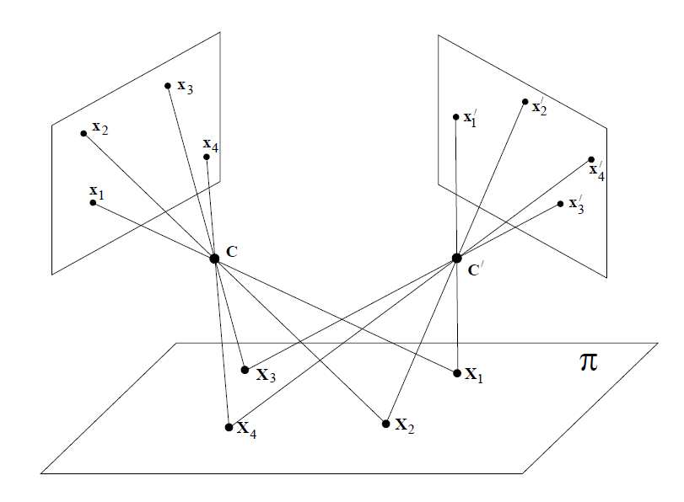


Problem of Homography Estimation
Note: Theoretically speaking, homography can only be estimated between two planes, i.e., when you use such a technique to stitch two images, image contents should be roughly on the same plane

Slide 5
Problem of Homography Estimation
4 point-correspondence pairs can uniquely determine a homography matrix since each correspondence pair solves two degrees of freedom
Note: here we assume that the matching points are all finite points (no points at infinity)

Slide 6
Problem of Homography Estimation
4 point-correspondence pairs can uniquely determine a homography matrix since each correspondence pair solves two degrees of freedom
Thus, four correspondence pairs generate 8 equations

Slide 7
Problem of Homography Estimation
4 point-correspondence pairs can uniquely determine a homography matrix since each correspondence pair solves two degrees of freedom
Normally, ; thus (1) has 1 (9-8) solution vector (linear independant) in its solution space
In our case, since we have n>4 point pairs, we get
It is an overdetermined homogeneous linear equation system

Slide 8
Problem of Homography Estimation
Since only the ratios among the elements of H take effect, in another way we can fix h₃₃=1 (suppose that h₃₃!=0),
Since we have n>4 point pairs, we get
It is an overdetermined inhomogeneous linear equation system

Slide 9
Outline
Problem of Homography Estimation
RANSAC-based Homography Estimation

Slide 10
RANSAC-based Homography Estimation
When there are more than 4 correspondence pairs, is it a proper way to use the LS method to solve the model directly?
NO! Because usually, outliers exist among the correspondence pairs
RANdom SAmple Consensus (RANSAC) is an iterative framework to estimate a parametric model from observations with noisy outliers

Slide 11
RANSAC-based Homography Estimation
Objective
Robust fit a model to a data set S which contains outliers
Algorithm
Randomly select a sample of s data points from S and instantiate the model from this subset
Determine the set of data points S_{i} which are within a distance threshold t of the model. The set S_{i} is the consensus set of the sample and defines the inliers of S
If the size of S_{i} (the number of inliers) is greater than some threshold T, re-estimate the model using all points in S_{i} and terminate
If the size of S_{i} is less than T, select a new subset and repeat the above
After N trials the largest consensus set S_{i} is selected, and the model is re-estimated using all points in the subset S_{i}

Slide 12
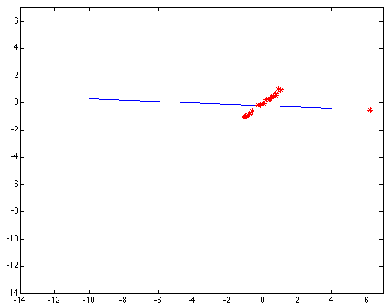
RANSAC-based Homography Estimation

Slide 13
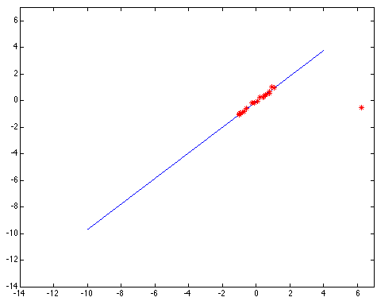
RANSAC-based Homography Estimation

Slide 14
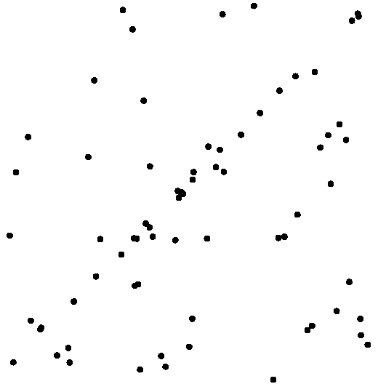
RANSAC-based Homography Estimation
Line fitting by RANSAC

Slide 15
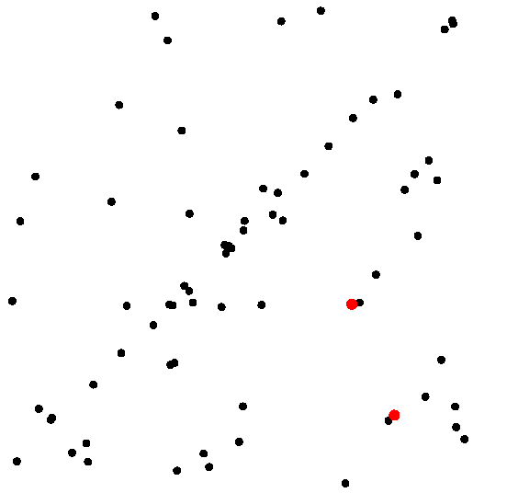
RANSAC-based Homography Estimation
Line fitting by RANSAC
Randomly select two points

Slide 16
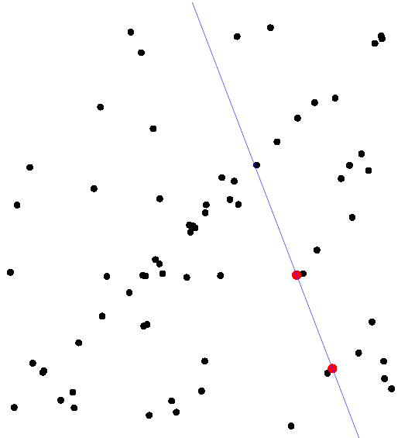
RANSAC-based Homography Estimation
Line fitting by RANSAC
Randomly select two points
The hypothesized model is the line passing through the two points

Slide 17
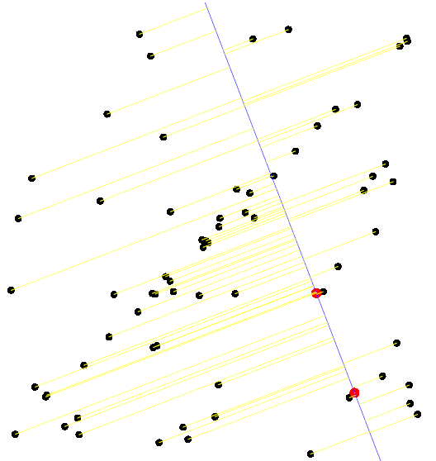
RANSAC-based Homography Estimation
Line fitting by RANSAC
Randomly select two points
The hypothesized model is the line passing through the two points

Slide 18
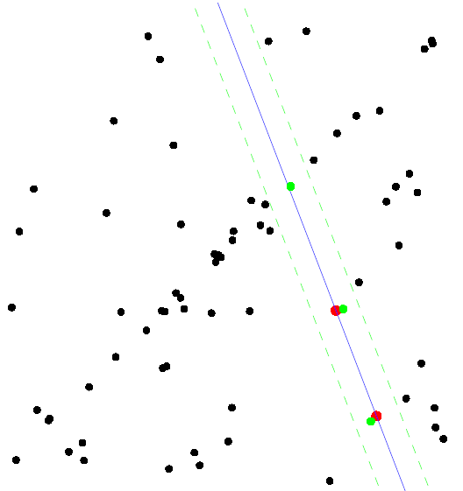
RANSAC-based Homography Estimation
Line fitting by RANSAC
Randomly select two points
The hypothesized model is the line passing through the two points

Slide 19
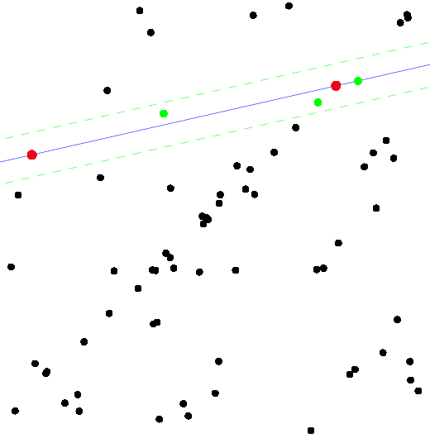
RANSAC-based Homography Estimation
Line fitting by RANSAC
Test another two points

Slide 20
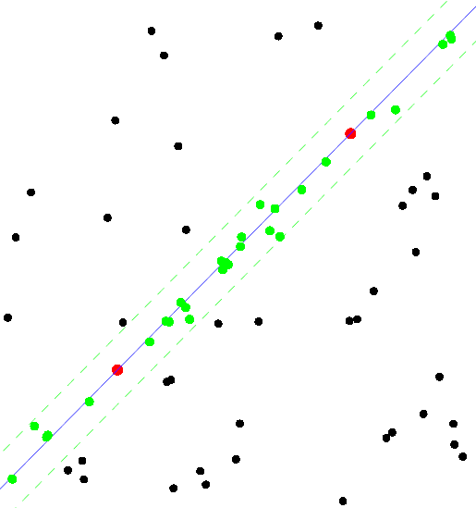
RANSAC-based Homography Estimation
Line fitting by RANSAC
The final fitting result

Slide 21
RANSAC-based Homography Estimation
Line fitting by RANSAC
The final fitting result

Slide 22

RANSAC-based Homography Estimation
Can you describe the steps of homography estimation when using RANSAC?

Slide 23
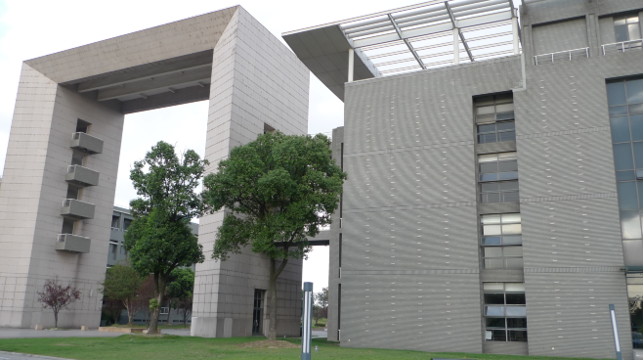
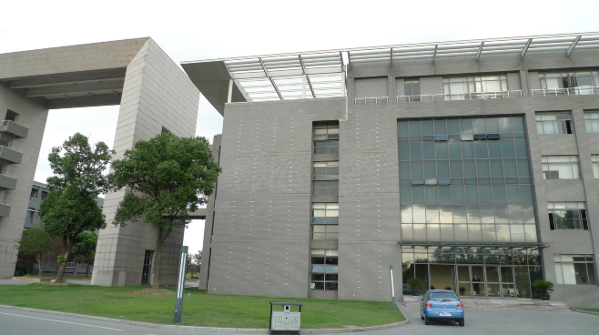
Homography Estimation: Example 1

Slide 24
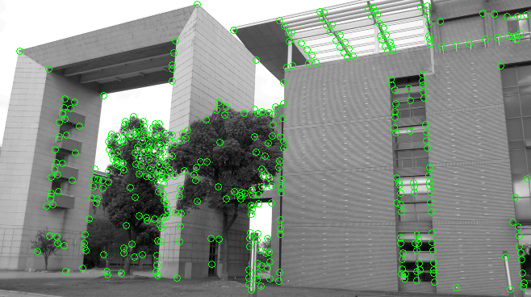
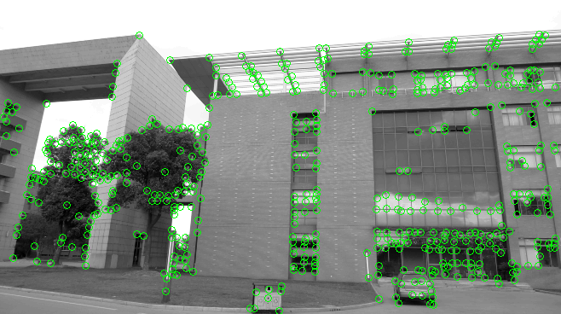
Homography Estimation: Example 1
Interest points detection

Slide 25
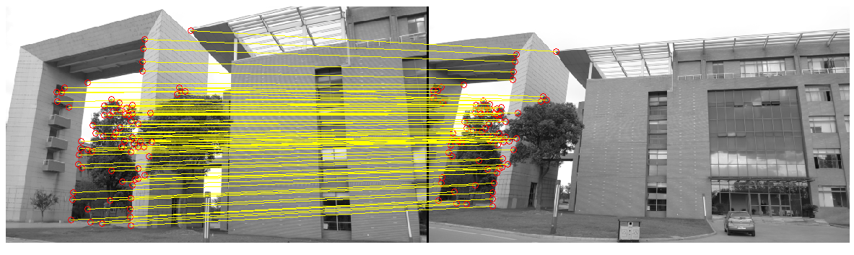
Homography Estimation: Example 1
Correspondence estimation
Then, the homography matrix can be estimated by using the correspondence pairs with RANSAC

Slide 26
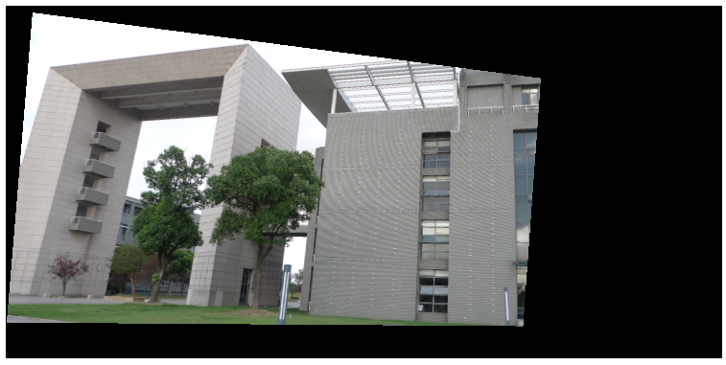
Homography Estimation: Example 1
Transform image one using the estimated homography matrix

Slide 27
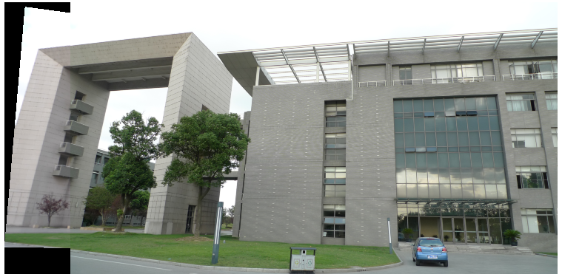
Homography Estimation: Example 1
Finally, stitch the transformed image one with image two

Slide 28


Homography Estimation: Example 2

Slide 29
Homography Estimation: Example 2
Interest points detection

Slide 30
Homography Estimation: Example 2
Correspondence estimation
Then, the homography matrix can be estimated by using the correspondence pairs with RANSAC

Slide 31
Homography Estimation: Example 2
Transform image one using the estimated homography matrix

Slide 32
Homography Estimation: Example 2
Finally, stitch the transformed image one with image two

Slide 33
Homography Estimation: Example 3
Project products of students from 2009 Media&Arts

Slide 34


